Slide 1
Linear Regression Analysis
with a vehicle dataset

Slide 2
Preprocessing The Data

Slide 3
Data
Data Preprocessing:
Originally 397 data points
1.5% of the data (6 data points) had missing values
Origin treated as Categorical
Cylinder number and Model year treated continuously
Total of Eight Variables:
Gas Mileage
Number of cylinders
Origin
Model year,
Displacement,
Horsepower,
Weight,
Acceleration,
Response (continuous)
Predictor (discrete)
Predictor (continuous)

Slide 4
Discussion of Models and Analyzing the Results
Original Full Model

Slide 5
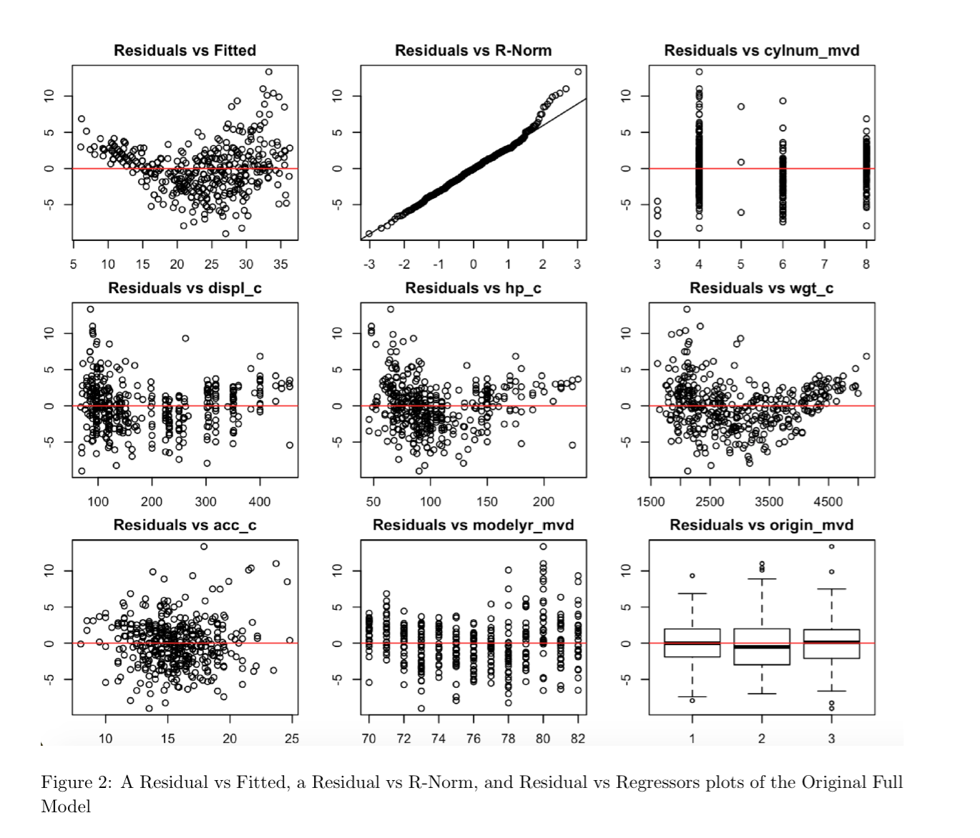
Mpg ~ Regressors
Independence: Kind of. Not really. Small quadratic pattern.
Linearity: Kind of. See later slides.
Mean Zero Errors: Mostly. There’s a lot above and a lot below the ab line.
Normality: Mostly. Light tailed the right
Constant Variance: Non-constant due to the shapes.

Slide 6
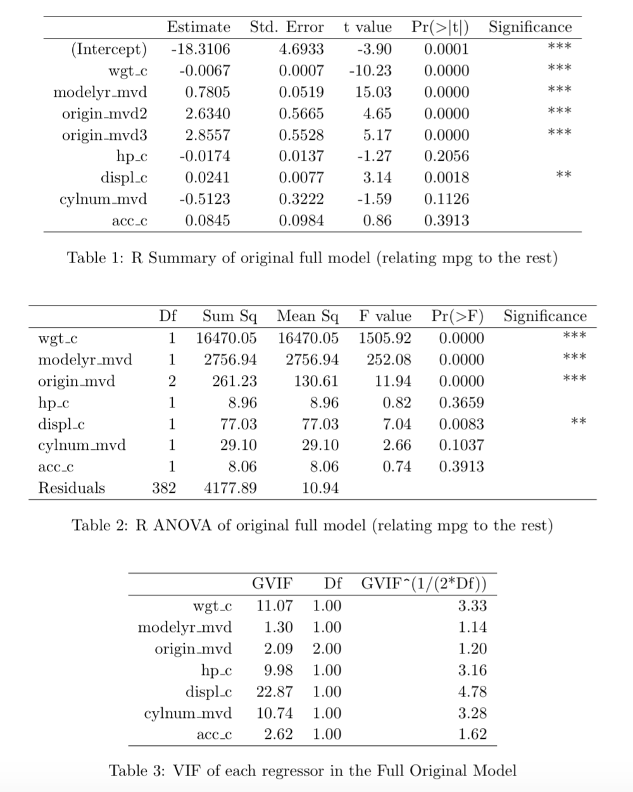
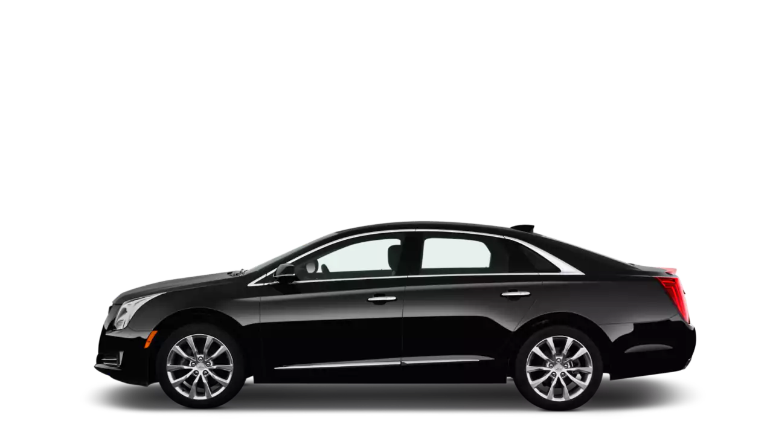
Summary / ANOVA:
Lots of significant regressors
VIF:
Suspected multicollinearity because of the high VIF of weight, hp, displacement, and cylinder number.

Slide 7
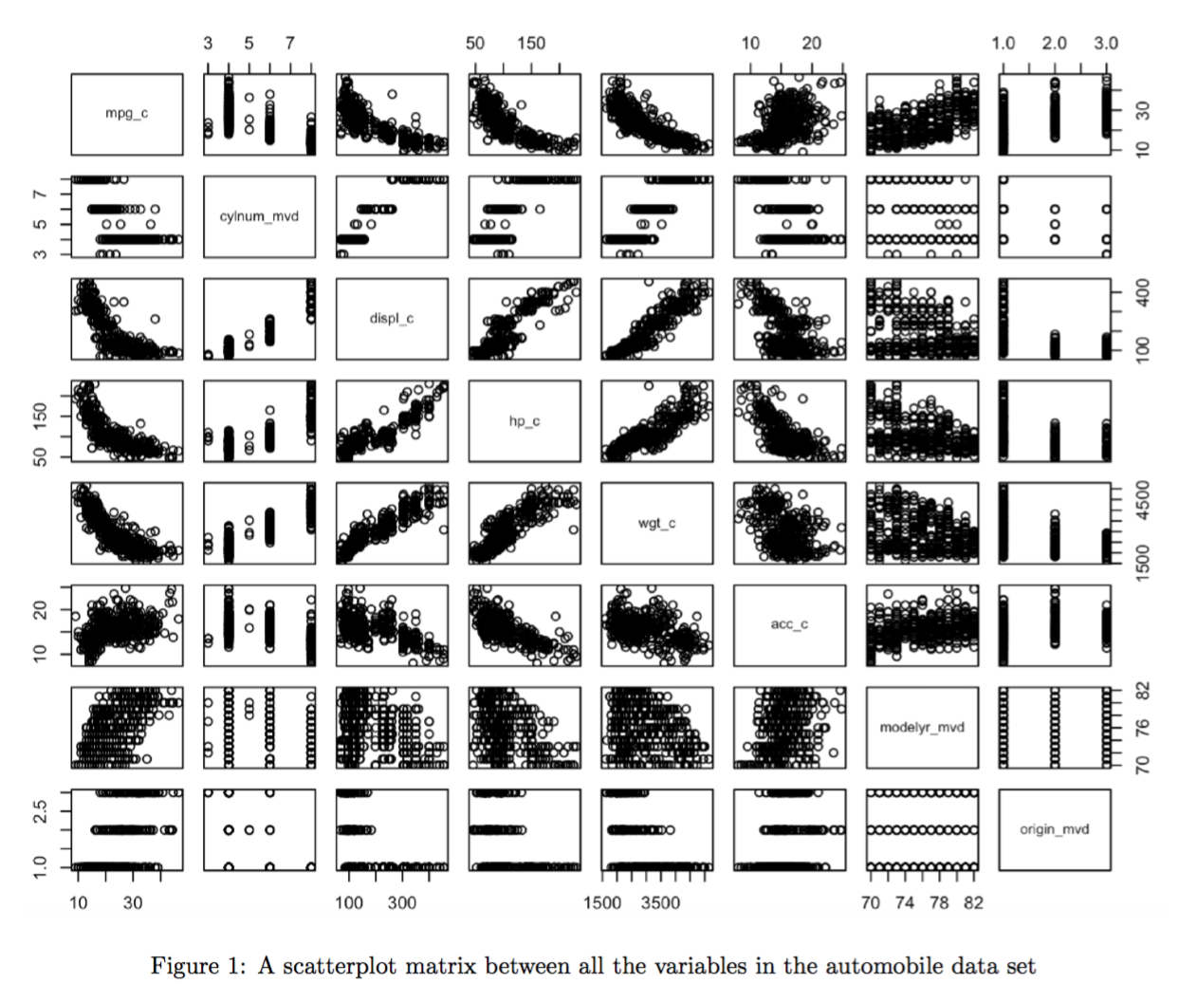
Multicollinearity
Displacement and Horsepower
Horsepower and Weight
Displacement and Weight
Horsepower and Acceleration
Displacement and Acceleration
Weight and Acceleration

Slide 8
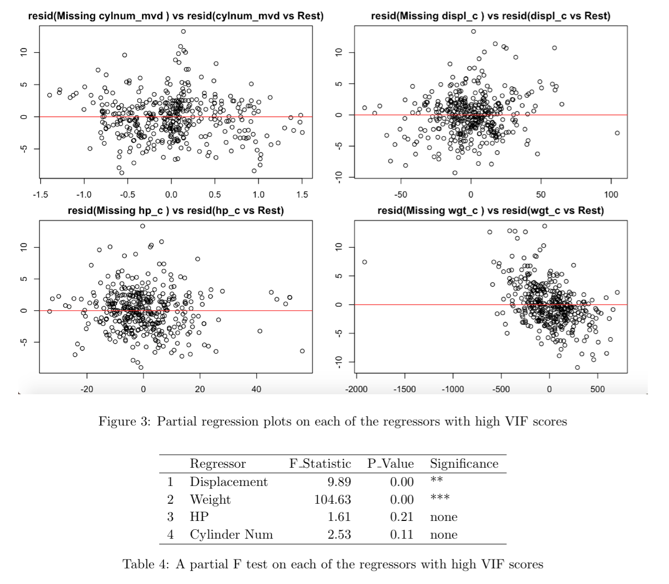
Further Inspection
Partial Regression says barely any pattern for everything except weight
Partial F Test says weight and displacement are significant
Should probably add an interaction term...

Slide 9
Discussion of Models and Analyzing the Results
Transformed Full Model

Slide 10
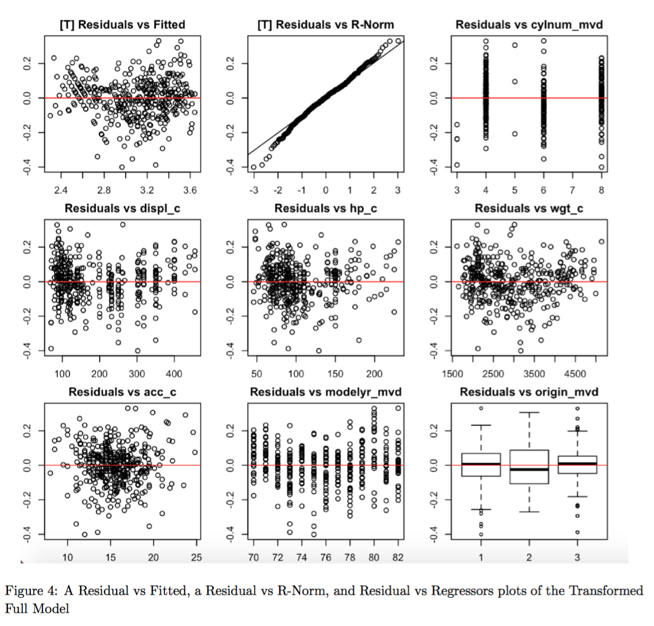
Log(Mpg) ~ Regressors
Independence: Much better. Less of a pattern.
Linearity: Higher R^2, less pattern in Residuals vs Fitted.
Mean Zero Errors: Better. Mostly half above, half below.
Normality: Light tailed on both sides now, but still OK.
Constant Variance: No obvious pattern in residuals.

Slide 11
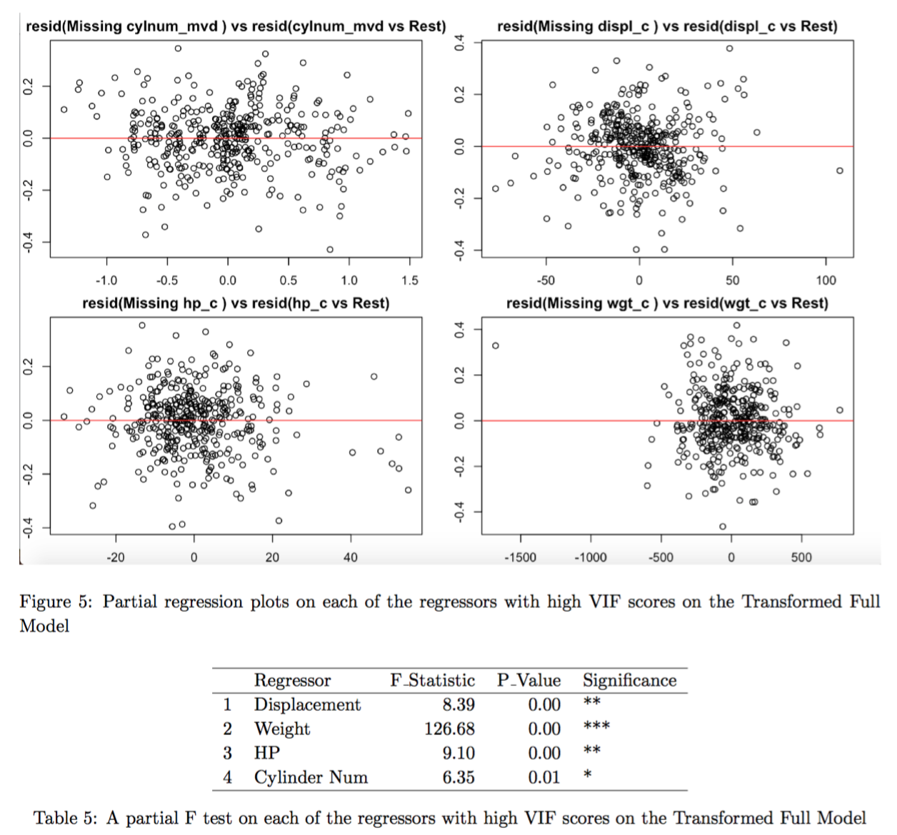
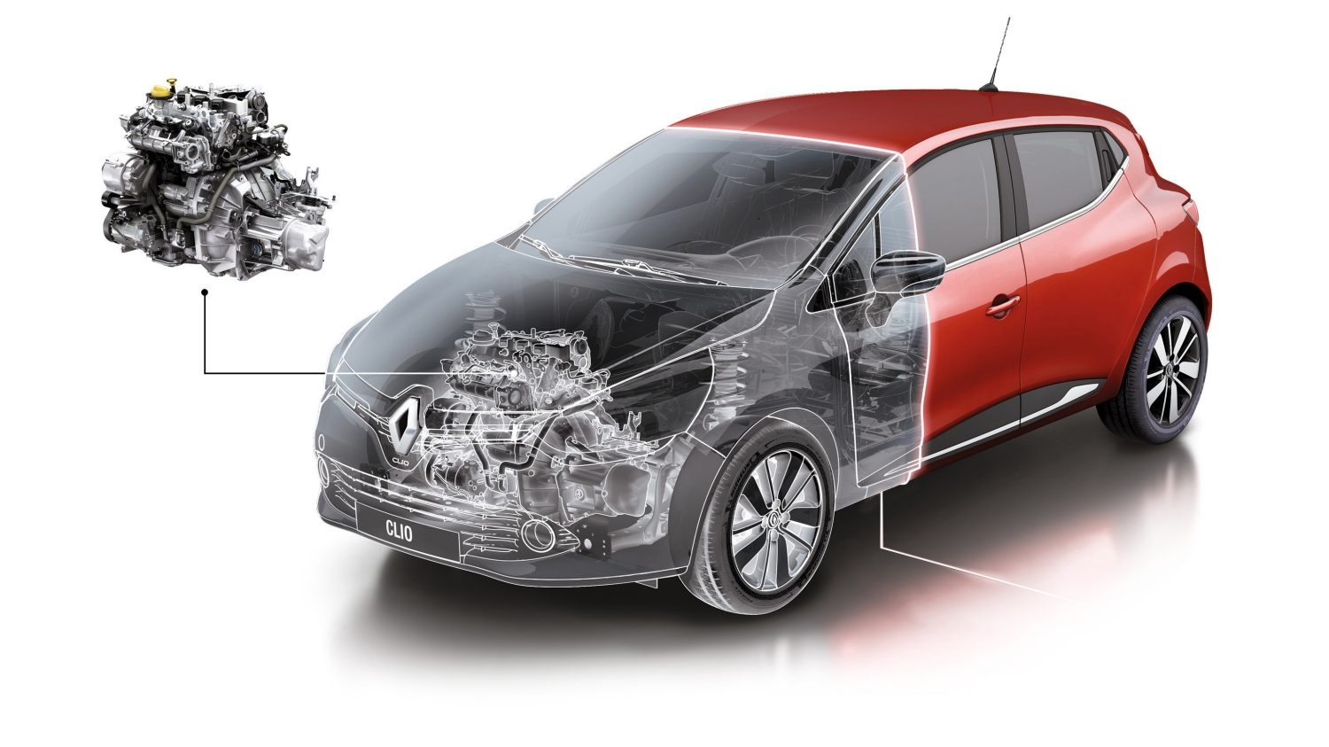
Post Transformation:
Now they’re all significant (per Partial F Test), but it’s even less obvious that they contribute (per Partial Regression Plots)... huh?

Slide 12
Discussion of Models and Analyzing the Results
Adding Interaction Terms

Slide 13
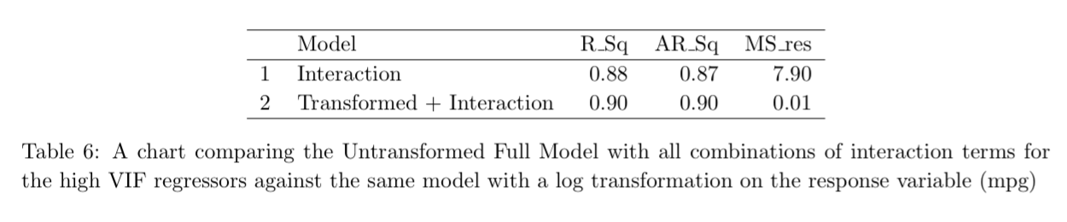
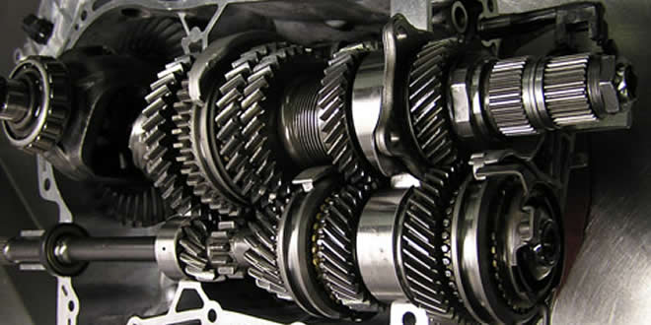

Slide 14
Discussion of Models and Analyzing the Results
Model Selection and Influential Points

Slide 15
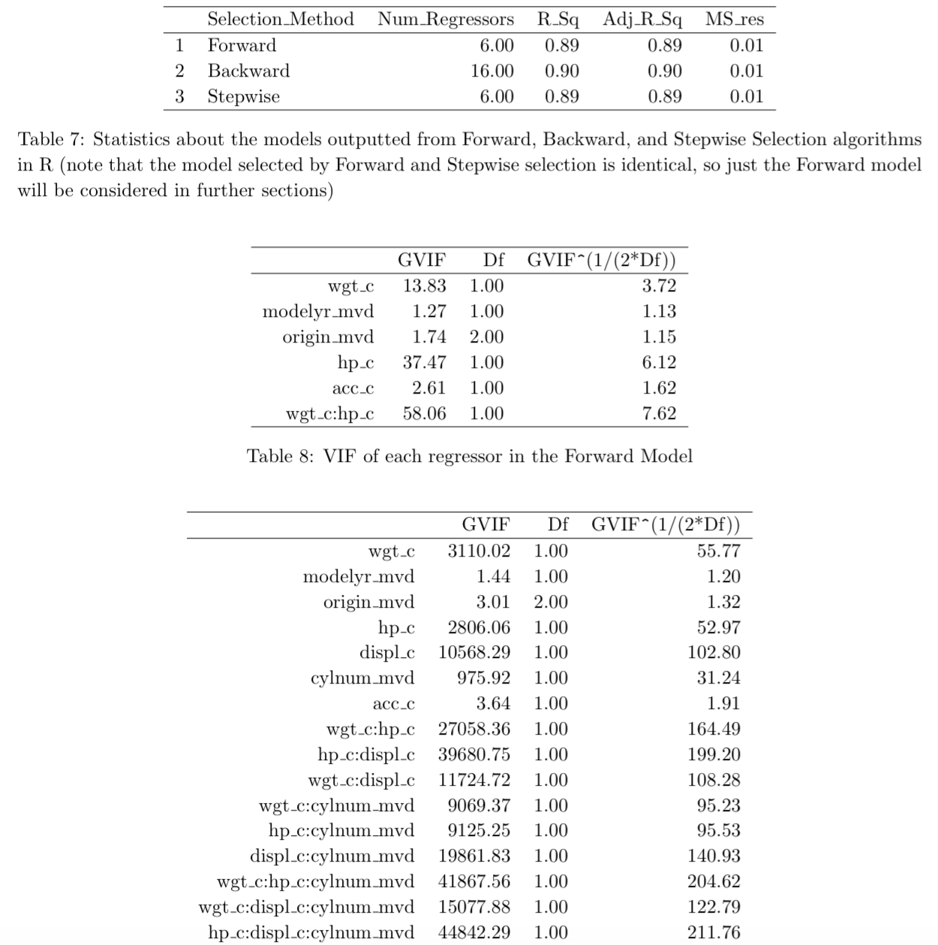
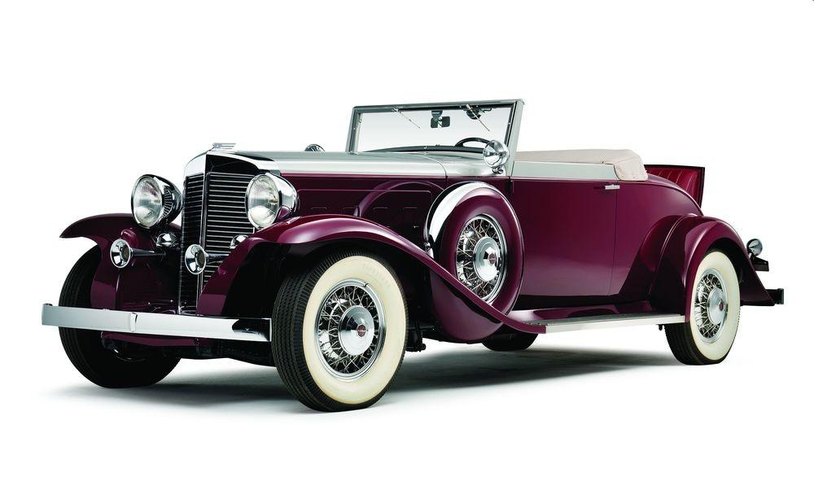
Further Inspection
Forward and Stepwise yielded the exact same model (same regressors)
Backward and Forward models have pretty similar R^2, but Backward has 16 regressors
VIF indicates HUGE correlation (which is ok, since they *are* correlated)

Slide 16
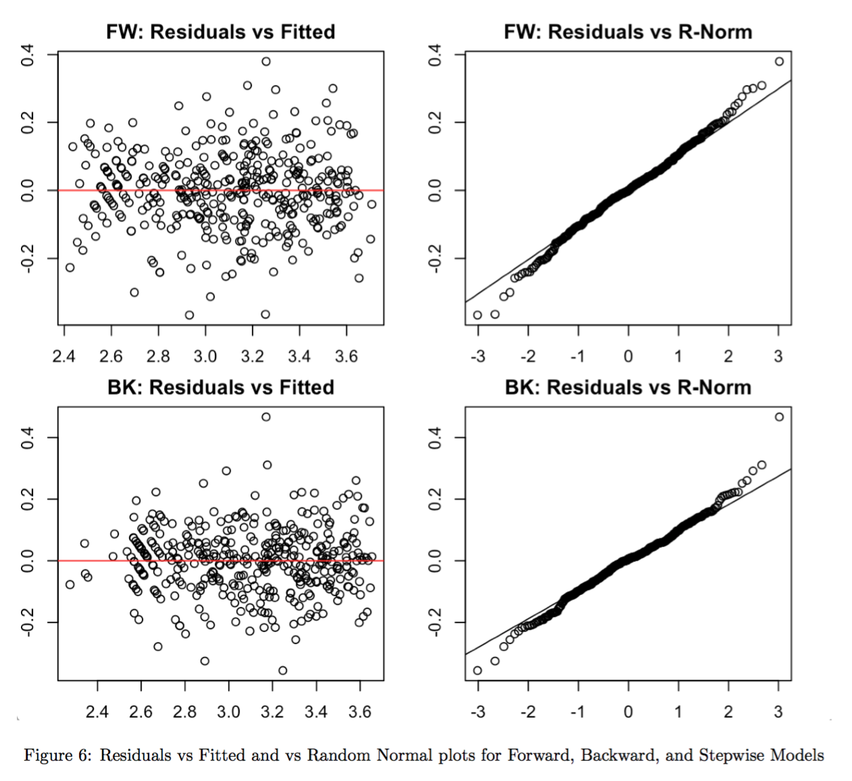
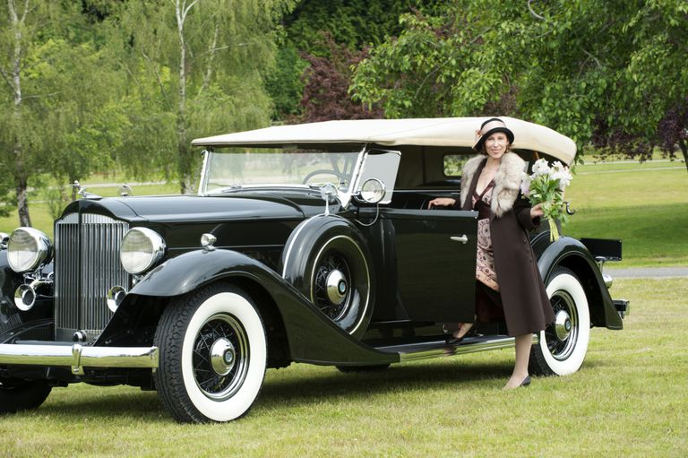
Further Inspection
Key assumptions look great for both models

Slide 17
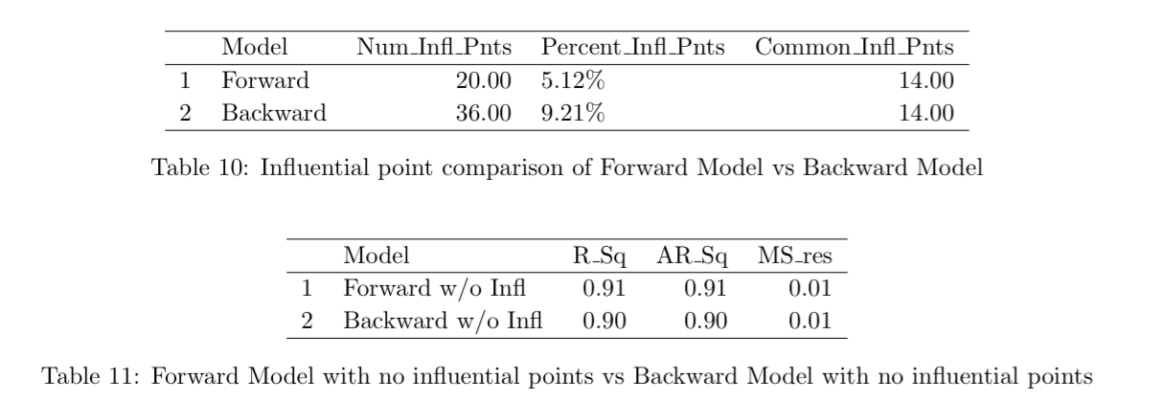
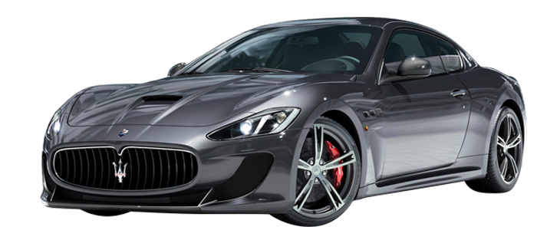
All else being equal, the forward model is more resilient to influential points...

Slide 18
Discussion of Models and Analyzing the Results
Final Model

Slide 19
